Slide 1
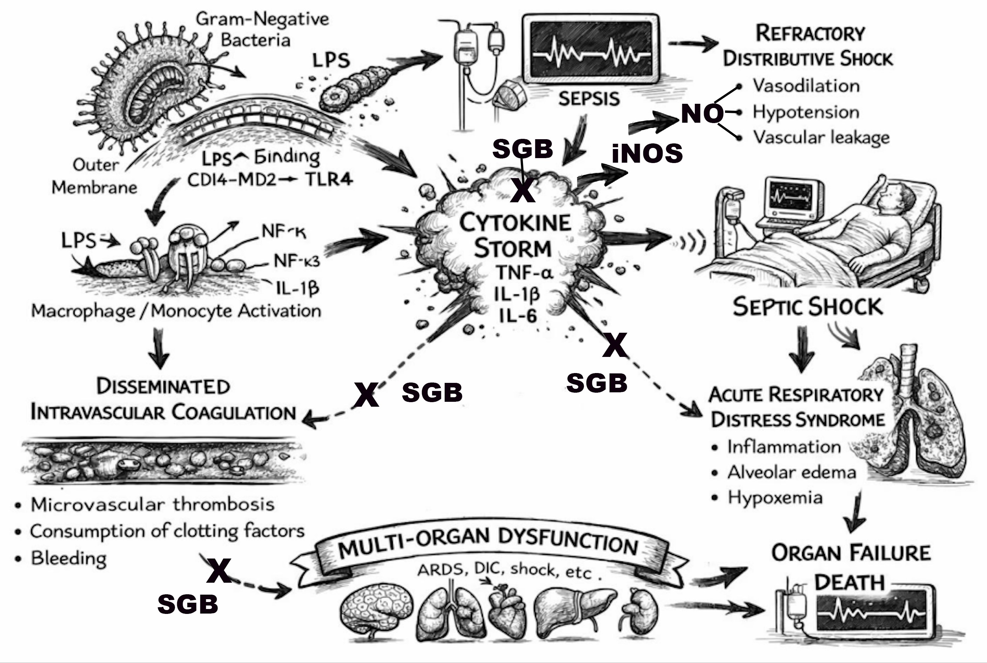
STELLATE GANGLION BLOCK AS A
ADJUNCTIVE THERAPY IN GRAM-NEGATIVE SEPTIC SHOCK:
A CLINICAL AND MECHANISTIC REVIEW
EUGENE LIPOV, M.D.¹ · SIDDHARTH NAIR, BS²
¹Stella Mental Health Center | ²Chicago College of Osteopathic Medicine, Midwestern University
Chicago, Illinois
INTRODUCTION
RESEARCH
METHODS
Gram-negative septic shock carries a mortality of 12–38%, driven by an LPS-induced cytokine storm (TNF-α, IL-1β, IL-6) causing refractory distributive shock, DIC, and ARDS.¹
The cytokine storm drives shock via upregulation of iNOS (inducible nitric oxide synthase), generating excess NO (nitric oxide) — producing profound vasodilation and decreased catecholamine responsiveness, the hallmark of refractory distributive shock.²
Gram-negative pathogens (E. coli, K. pneumoniae, P. aeruginosa) are leading causes of life-threatening bacteremia, with rising multidrug resistance compounding mortality risk.¹
Despite critical care advances, mortality remains unacceptably high, highlighting the urgent need for novel adjunctive therapies.
Figure 1: Pathogenesis of Gram-Negative Sepsis and Septic Shock
Narrative review synthesizing current preclinical and clinical evidence on gram-negative sepsis pathogenesis and the proposed mechanisms of SGB intervention.
Key databases searched: PubMed and Scopus, using terms: stellate ganglion block, cytokine storm, septic shock, autonomic modulation, and immunomodulation.
Study types included animal sepsis models, human clinical trials, and neuro endocrine axis reviews
CONCLUSIONS
DISCUSSION
SGB is potentially an adjunctive therapy targeting the core inflammatory and autonomic pathways of gram-negative septic shock.
Current evidence supports potential use of SGB in mitigating cytokine storm and downstream complications: refractory shock, DIC, and ARDS.
We believe SGB should be studied rigorously, demonstrating its abilities as an adjunct in gram negative sepsis treatment
Preclinical data (septic rat models) show SGB reduces cytokine levels and attenuates acute lung injury, validating biological plausibility.³
A 2023 clinical trial found SGB shortened mechanical ventilation duration in elderly patients with septic shock.⁴
Sympathetic innervation of both primary and secondary immune organs has been shown to increase norepinephrine signaling directly onto lymphocytes and innate immune cells via adrenergic receptors, thus suppressing pro-inflammatory cytokines (IL-1β, IL-6, TNF-α) while promoting anti-inflammatory mediators such as IL-10 and TGF-β.⁵
Considering above findings, we believe conducting large-scale multicenter RCTs to define optimal timing, dosing, and patient selection for adjunctive use of SGB is warranted
REFERENCES
1. Rudd KE, Johnson SC, Agesa KM, et al. Global, regional, and national sepsis incidence and mortality, 1990-2017: analysis for the Global Burden of Disease Study. Lancet. 2020;395(10219):200-211. doi:10.1016/S0140-6736(19)32989-7
2. Landry DW, Oliver JA. The pathogenesis of vasodilatory shock. N Engl J Med. 2001;345(8):588-595. doi:10.1056/NEJMra002709
3. Chen Y, Guo L, Lang H, et al. Effect of a stellate ganglion block on acute lung injury in septic rats. Inflammation. 2018;41(5):1601-1609. doi:10.1007/s10753-018-0803-x
4. Yuan Y, Chen L. Clinical effect of perioperative stellate ganglion block on mechanical ventilation and respiratory function of elderly patients with septic shock. Medicine. 2024;103(21):e38166. doi:10.1097/MD.0000000000038166
5. Lipov E, Gluncic V, Lukić IK, Candido K. How does stellate ganglion block alleviate immunologically-linked disorders? Med Hypotheses. 2020;144:110000. doi:10.1016/j.mehy.2020.110000

