Slide 1


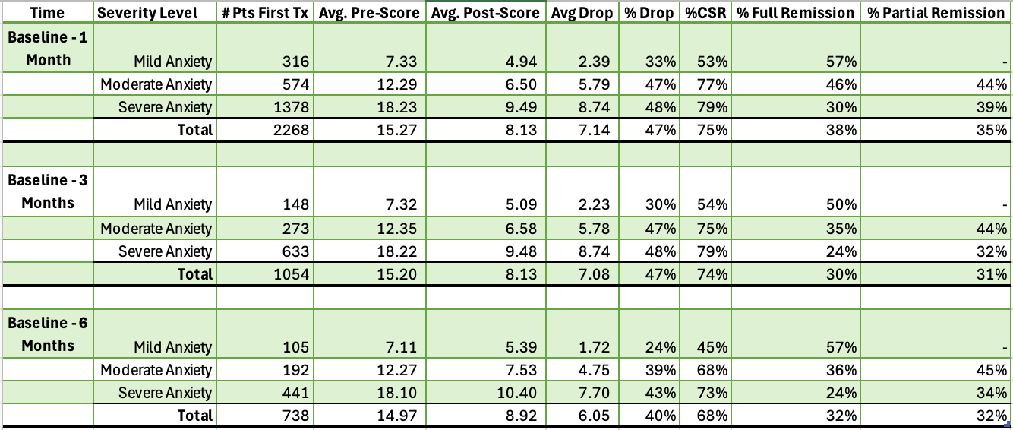
Utility of cervical sympathetic blockade in treating anxiety, a retrospective analysis of 2268 patients with up to 6 month follow up.
Eugene Lipov, MD^{1,2*}, Kaylee Stowe, OMS-III³
¹Stella Center, Westmont IL, ²Department of Surgery, University of Illinois, ³Midwestern University
Background
Cases
Discussion
Anxiety disorders are common and affect a large proportion of the U.S. population, significantly impacting quality of life and daily functioning. Common anxiety disorders include generalized anxiety disorder, social anxiety disorder, and panic disorder with or without agoraphobia. These disorders are associated with significant impairments in social and occupational functioning, increased healthcare utilization, and a reduced overall quality of life (Szuhany, 2022). Current treatment of anxiety consists of a combination of both pharmacology and psychotherapy
(Gautam, 2017), with selective serotonin reuptake inhibitors (SSRIs) or serotonin-norepinephrine reuptake inhibitors (SNRIs) commonly used alongside cognitive-behavioral therapy as first-line interventions (Szuhany, 2022; Carpenter et al., 2018). One treatment area of particular interest is the cervical sympathetic block (CSB). CSB. Stellate ganglion block (SGB), as well as the modern version known as dual sympathetic reset (DSR), where C4 and C6 injections are done on the same side, has been used safely for nearly 100 years to treat sympathetically mediated pain syndromes and other autonomic disorders (More, 1954). Local anesthetic injection of cervical sympathetic ganglions can lead to immediate reduction of NE, as well as the removal of extra sympathetic nerve fibers, leading to long-term reduction of NE. CSB has level 1b evidence to support its use in PTSD; considering the well-established benefits of CSB in treating PTSD symptoms and the significant connection between PTSD and anxiety symptoms, with likely similar pathophysiology of increased norepinephrine, it can be conceptually understood that anxiety symptoms should also
respond to CSB.
METHODS
Patients for this retrospective analysis were treated in multiple offices under the Stella center
network, which is an international organization, providing CSB following a specific protocol which is noted below. 2,268 patients who had a GAD pre- /post-score within one month of treatment were included. For cervical sympathetic blockade description, see Lipov, 2022. Psychiatric measure outcomes were completed with the GAD-7. A change in GAD-7 score by 4 points is considered clinically significant. Full remission is considered when patients have mild or greater anxiety that was reduced to no anxiety. Partial remission is considered when patients have moderate or greater anxiety that was reduced to mild anxiety.
RESULTS
From baseline to one-month post-procedure, data from 2,268 patients were analyzed.
Severe anxiety: 1,378 patients had severe anxiety, with an average baseline score of 18.23. Following CSB treatment, the average GAD-7 score decreased to 9.49, reflecting an average reduction of 8.74 (48%) points. A clinically significant response was observed in 79% of patients, with 30% achieved full remission and 39% achieving partial remission.
Moderate anxiety: 574 patients had moderate anxiety, with an average baseline score of 12.29. Following CSB treatment, the average GAD-7 score decreased to 6.5, reflecting an average reduction of 5.79 points (47%). A clinically significant response was observed in 77% of patients, with 46% achieving
full remission and 44% experiencing partial remission.
Mild anxiety: 316 patients had mild anxiety, the average baseline score was 7.33. Following CSB
treatment, the average GAD-7 score decreased to 4.94, representing an average reduction of 2.39
points (33%). A clinically significant response was observed in 53% of patients, while 57%
achieved full remission.
The overlap of PTSD and anxiety symptoms is common and, therefore, allows for the extrapolation of the same mechanism to work for an alternate diagnosis, such as generalized anxiety disorder (GAD). This overlap is likely due to a common mechanism involving norepinephrine (NE) concentrations, which are affected by the NE system and can modulate
anxiety disorders such as PTSD. In these disorders, there appears to be a complex dysregulation of NE system function, secondary to changes in the locus coeruleus. Many symptoms of these disorders are attributable to abnormalities within distributed neural circuits regulated by NE, or dysregulation and increased NE levels. (Ressler, 2001) The NE dysfunction is likely correctable by CSB as described in more detail in prior publication (Lipov, 2009).
Conclusion
Overall, CSB treatment resulted in a decrease in GAD-7 scores of near twice the minimal clinically important difference for treating anxiety. This effect was sustained for up to six months following the CSB injection. Thus, CSB should be explored as a safe and rational therapeutic option for treating generalized anxiety disorder (GAD) symptoms or other anxiety disorders (e.g., panic disorder, social anxiety disorder, specific phobias).
References
Szuhany, K.L.; Simon, N.M. Anxiety Disorders: A Review. JAMA 2022, 328, 2431–2445.
Gautam, S. (2017). Pharmacotherapy in anxiety disorders. Indian Journal of Psychiatry, 59(1), 4-9.
https://doi.org/10.4103/0019-5545.198320
Moore, D.C. Stellate Ganglion Block: Techniques, Indications, Uses; Thomas: Springfield, IL, USA, 1954.
Lipov, E.G.; Jacobs, R.; Springer, S.; Candido, K.D.; Knezevic, N.N. Utility of Cervical Sympathetic Block
in Treating Post-Traumatic Stress Disorder in Multiple Cohorts: A Retrospective Analysis. Pain Physician
2022, 25, 77–85.
Notes:
Font size minimum 24 (20 for references)
Jpeg or png, resolution 72 or 96 dpi
Save as PDF file
Title: 72-120 pt.
Subtitle: 48-80 pt.
Section headers: 36-72 pt.
Body text: 24-48 pt
300-800 words

