Slide 1

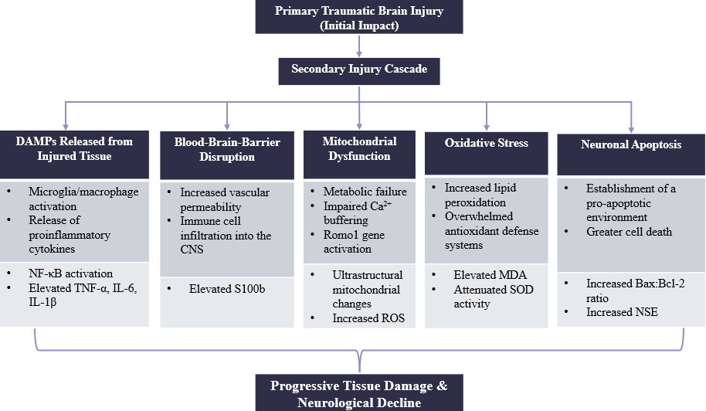
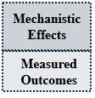
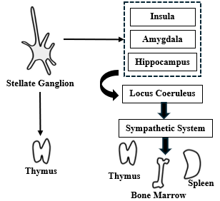
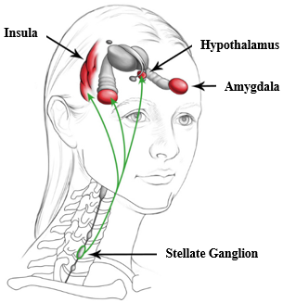
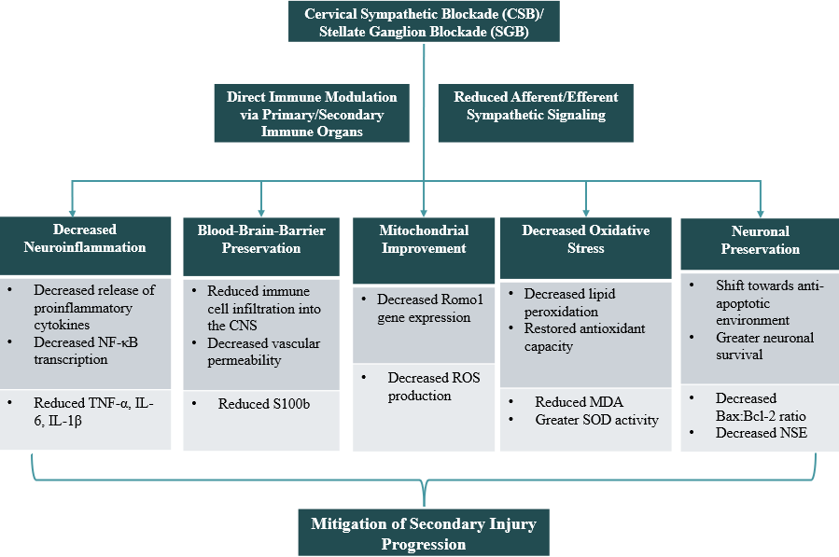
Utility of Sympathetic Nervous System Modulation for the Treatment of Traumatic Brain Injury (TBI): An Immune, Mitochondrial, Oxidative Stress, and Genetic Perspective
¹Jordan Patierno, ²Eugene Lipov
¹Midwestern University Chicago College of Osteopathic Medicine, Downers Grove IL; ²Stella Center, Westmont IL
Secondary Injury in TBI
Clinical Impacts
– TBI has a biphasic clinical course, where secondary injury drives progressive neurological decline
– Secondary injury mechanisms entail a cascade of neuroinflammation, mitochondrial dysfunction, oxidative stress, apoptosis activation, and maladaptive gene regulation
– While current TBI management greatly reduces mortality, it does not fully address the underlying secondary injury mechanisms
– Reduction in TBI-related symptom burden, with 40–50% improvements in Neurobehavioral Symptom Inventory (NSI) scores at 1–3 months
– Clinical benefits persist well beyond the half-life of the local anesthetic agent
Impact on Neuroinflammation
– Reduces pro-inflammatory cytokines (IL-6, TNF-α, IL-1β) in both acute and subacute brain injury contexts
– Downregulation of NF-κB signaling, a central transcriptional driver of neuroinflammation
– Decreases S100b, a marker of BBB disruption/astroglia activation, and NSE, marking reduced neuronal stress
Stellate Ganglion Block (SGB)/Cervical Sympathetic Block (CSB)
– SGB/CSB anesthetize the stellate ganglion and superior cervical ganglion with bupivacaine
– Cervical sympathetic ganglia (CSG) project sympathetic fibers to the ipsilateral brain, head, neck, upper extremity, and upper part of the thorax
– The CSG connects directly to primary and secondary immune organs: thymus, bone marrow, and spleen
Impact on Oxidative Stress/Mitochondrial Function
– Reduces levels of Malondialdehyde (MDA), a marker of oxidative stress
– Augments Superoxide dismutase (SOD) activity, a key player in the mitochondrial antioxidant defense system
– Downregulates Reactive Oxygen Species Modulator-1 (Romo1), a mitochondrial inner-membrane protein critical for Reactive Oxygen Species (ROS) generation
Clinical Application of SGB/CSB
– SGB/CSB has the potential to mitigate key mechanisms underlying secondary injury in TBI
– SGB/CSB has been used extensively for menopausal hot flashes, post-traumatic stress disorder, immune-related disorders, post-operative cognitive decline prevention
Impact on Neuronal Apoptosis
Methods
– Shifts apoptotic signaling toward neuronal survival by decreasing Bax and increasing Bcl-2 expression
– Supports a mechanistic link between sympathetic modulation and preservation of neuronal viability
– Narrative review synthesizing experimental and observational studies evaluating clinical and mechanistic effects of SGB/CSB related to TBI
– PubMed, Google Scholar, citation chaining of key articles
– Full text articles reviewed if relevant to:
TBI or secondary brain injury mechanisms
Effects of SGB/CSB on clinical outcomes or biological pathways relevant to TBI
Discussion
NF-κB= nuclear factor kappa-light-chain-enhancer of activated B cells; IL-6= interleukin-6; IL-1β= interleukin-1beta; TNF-α= tumor necrosis factor alpha; S100b= S100 calcium-binding protein B; NSE= neuron specific enolase; Romo1= reactive oxygen species modulator 1; ROS= reactive oxygen species; Bax= BCL2 associated X protein; Bcl-2= B cell lymphoma 2 protein; MDA= malondialdehyde; SOD= superoxide dismutase
SGB/CSB targets key pathways central to secondary injury in TBI supporting a mechanistically grounded therapeutic effect
Notes:
1

