Slide 1
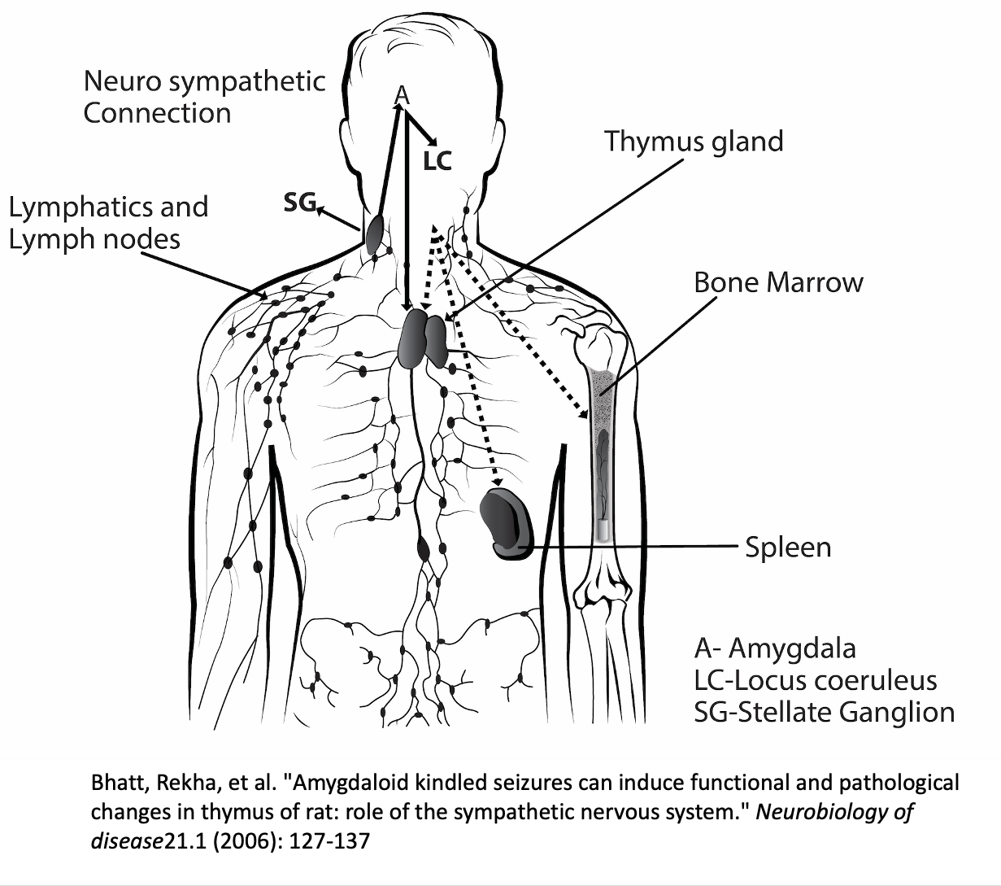
Role of Stellate Ganglion Block in Treating Oxidative Stress and Cognitive Decline in the post operative setting A brief review .
Eugene Lipov¹, Kevin Marmo²,
Introduction
Stella Mental Health, Westmont, IL
Discussion
Recent studies suggest Stellate ganglion block (SGB) has the potential to mitigate coronary heart disease, reduce oxidative stress, and Improve cognitive function. However, the precise mechanisms are underexplored.
Dr. Xue (2025) demonstrated improvements in postoperative cognitive dysfunction, which correlated with reduced oxidative stress, shown by the reduction of interleukin-6 (IL-6) and superoxide dismutase (SOD). Additionally, Dr. Jin (2025) reported increased cerebral blood flow (CBF) and enhanced endothelial function, leading to improved recovery in myocardial infarction in animal models. These effects again appear to be mediated by reductions in pro-inflammatory cytokines and upregulation of vasodilation-related genes such as NOS3.
The promising findings from recent studies on stellate ganglion block (SGB) suggest its potential to significantly impact several areas of health, particularly cognitive function, cardiovascular health, and oxidative stress. However, while the evidence supports the therapeutic benefits of SGB, there are several important considerations and avenues for further exploration.
Mechanisms of Action One of the key findings across studies is the role of SGB in reducing oxidative stress, which is crucial in both aging and various chronic diseases, including coronary heart disease. The reduction in inflammatory markers like interleukin-6 (IL-6) and the increase in antioxidant enzymes like superoxide dismutase (SOD) indicate that SGB may help restore a more balanced immune response, improving both vascular and neural health. Additionally, the upregulation of NOS3, a vasodilation-related gene, suggests that SGB may help maintain or restore endothelial function, which is critical for optimal cardiovascular health.
However, the precise mechanisms through which SGB exerts these effects are not fully understood. The anatomical connections between the stellate ganglion and the bone marrow, thymus, and spleen offer potential pathways for modulating immune responses and vascular health. Further research into the molecular and cellular processes activated by SGB could help clarify its mechanisms and expand its clinical applications.( ref)
Impact on Cognitive Function The improvements in cognitive function observed in both human and animal studies raise important questions about how SGB might be utilized to treat cognitive decline in an acute setting . Dr. Xue’s human study demonstrated that elderly patients undergoing surgery experienced better cognitive outcomes when treated with SGB. Dr. Jin’s animal model of myocardial infarction showed that SGB improved cognitive recovery by enhancing cerebral blood flow (CBF) and stabilizing neural activity.
These findings suggest that SGB may be a viable treatment option for postoperative cognitive dysfunction (POCD) and could have broader applications for neurodegenerative diseases such as Alzheimer’s or Parkinson’s. However, the mechanism by which SGB specifically improves cognition—whether through better blood flow, reduced inflammation, or some other pathway—requires further investigation. In addition, determining the long-term effects of SGB on cognitive function will be crucial for understanding its role in preventing or treating chronic cognitive impairments.
Cardiovascular Benefits Cardiovascular health improvements with SGB, particularly in relation to endothelial function and cardiac recovery, are also noteworthy. The modulation of endothelial nitric oxide synthase (NOS3) expression points to a direct mechanism through which SGB could improve blood vessel function and reduce the risk of cardiovascular disease. Dr. Jin’s findings in rats with myocardial infarction suggest that SGB may have therapeutic potential for patients with coronary heart disease, offering an alternative to traditional invasive procedures.
However, while animal models provide compelling data, more clinical trials are necessary to confirm the applicability of these results to human populations. The long-term effects of SGB on heart disease outcomes, including its ability to prevent or treat chronic conditions like hypertension and atherosclerosis, remain to be explored.
Sympathetic Nervous System Modulation SGB’s role in modulating the sympathetic nervous system (SNS) is presumed to be central to its therapeutic effects. Yet , SNS plays a key role in regulating inflammation and immune responses, and the stellate ganglion’s connections to critical immune organs—such as the bone marrow, thymus, and spleen—suggest that SGB may influence systemic immune function in addition to its local effects on the heart and brain. This modulation of SNS activity could have broad implications for a variety of inflammatory and autoimmune disorders. The exact role of the SNS in SGB’s therapeutic effects is still a subject of debate. While some studies have demonstrated reduced sympathetic activity post-SGB, others have raised concerns about the long-term impact of altering the SNS. More research is needed to better understand how SGB affects the SNS and whether prolonged or repeated treatments could lead to unintended consequences, such as changes in heart rate variability or blood pressure.
Hypothesis
Stellate ganglion block (SGB) is hypothesized to exert its effect on cognitive improvement and reduction of oxidative stress by modulating the immune system via the direct neurological connection of sympathetic nerves to the bone marrow, thymus, and spleen. This, in turn, produces effects seen.
methods
Brief review of relevant studies
A randomized controlled trial in elderly patients undergoing laparoscopic gastrointestinal surgery to assess the impact of ultrasound-guided SGB on postoperative cognitive dysfunction (POCD) with the placebo control group.
Cognitive function was assessed by using standardized neuropsychological tests preoperatively and postoperatively. Oxidative stress markers, including interleukin -6 IL-6 and superoxide dismutase (SOD), were collected via blood samples.((Dr. Xue, 2025)
Rats with experimentally induced myocardial infarction (MI) were treated with left-sided SGB and assessed for cognitive function change. Control rats underwent a sham procedure.
Brain function was monitored by monitoring of cerebral blood flow (CBF) in the left frontal region of the brain. Using Laser Doppler Flowmetry (LDF) ; Electroencephalography (EEG) recorded neural activity. Cognitive recovery was evaluated through behavioral tests, including memory and learning assessments. Cardiac and endothelial function were monitored using echocardiography and blood pressure measurements. Blood analysis of gene expression levels of (IL-6) and vasodilation-related genes (NOS3) were performed.((Dr. Jin, 2025)
References
1. Xue, Ruyue, et al. "Improved Early Postoperative Cognition in Elderly Gastrointestinal Patients: A Randomized Controlled Trial on the Role of Ultrasound-Guided Stellate Ganglion Block." Frontiers in Aging Neuroscience 17: 1503314.
2. Jin, Zhehao, et al. "Revealing the molecular links between coronary heart disease and cognitive impairment: the role of aging-related genes and therapeutic potential of stellate ganglion block." Biogerontology 26.1 (2025): 1-21
3. Porzionato A, Emmi A, Barbon S, Boscolo‐Berto R, Stecco C, Stocco E, Macchi V, De Caro R. Sympathetic activation: a potential link between comorbidities and COVID‐19. The FEBS journal. 2020 Sep;287(17):3681-8.
4. Lipov EG, Joshi JR, Sanders S, Slavin KV. A unifying theory linking the prolonged efficacy of the stellate ganglion block for the treatment of chronic regional pain syndrome (CRPS), hot flashes, and posttraumatic stress disorder (PTSD). Medical hypotheses. 2009 Jun 1;72(6):657-61.
5. Lipov E, Gluncic V, Lukić IK, Candido K. How does stellate ganglion block alleviate immunologically-linked disorders? Medical hypotheses. 2020 Nov 1;144:110000.
6. Long-term Results of Stellate Ganglion Block in Patients with Olfactory Dysfunction
Ho Sik Moon, MD, Jin Young Chon, MD, Sang Hoon Lee, MD, Yu Mi Ju, MD, and Choon Ho Sung, MD
https://www.ncbi.nlm.nih.gov/pmc/articles/PMC3546212/#
7. Lee NS, Kim BG, Park JM, Park YS, Kim SW, Kim SW, et al. The effect of superior cervical ganglionectomy on recovery of olfaction in induced anosmic mice. Korean J Otolaryngol-Head Neck Surg. 2005;48:1462–146
8. Bhatt, Rekha, et al. “Amdaloid kindled seizures can induce functional and pathological changes in the thymus of rat: role of the sympathetic nervous system.” Neurobiology of disease21.1 (2006): 127-137
Conclusion
Results
The emerging body of research on stellate ganglion block (SGB) presents compelling evidence for its multifaceted therapeutic potential, particularly in the contexts of cognitive function, cardiovascular health, and oxidative stress. Based on the findings from recent studies, we can conclude:
Neuroprotective Effects: SGB appears to enhance cognitive function, particularly in elderly patients undergoing surgery. This effect is likely mediated by improved cerebral blood flow (CBF) and the reduction of systemic inflammation, as evidenced by decreased levels of interleukin-6 (IL-6) and increased antioxidant activity (e.g., superoxide dismutase, SOD). These improvements in cognitive function suggest that SGB could be a valuable intervention for managing postoperative cognitive dysfunction (POCD) and potentially other forms of cognitive decline, such as those seen in aging or neurodegenerative conditions.
Cardioprotective and Endothelial Benefits: In animal models of myocardial infarction (MI), left-sided SGB demonstrated significant improvements in endothelial and cardiac function. The upregulation of vasodilation-related genes such as NOS3 and the reduction of pro-inflammatory cytokines contribute to better vascular health, potentially offering a novel therapeutic strategy for patients with coronary heart disease or other cardiovascular conditions.
Reduction of Oxidative Stress: SGB’s ability to reduce oxidative stress, as evidenced by the modulation of IL-6 and SOD levels, provides a mechanism for its broader therapeutic effects. By reducing oxidative damage, SGB may help reverse or slow the effects of biological aging and prevent the exacerbation of age-related diseases. This suggests that SGB could be an adjunctive treatment for aging-related conditions, improving both systemic and cognitive health.
Sympathetic Nervous System Modulation: The interaction between the sympathetic nervous system (SNS) and immune responses via anatomical connections to the bone marrow, thymus, and spleen is central to the beneficial effects of SGB. By modulating SNS activity, SGB reduces inflammation and promotes systemic homeostasis, which likely contributes to its diverse clinical benefits.
Human Model
Reduced IL-6 levels in SGB-treated patients, indicating lowered systemic inflammation.
Increased SOD activity, reflecting enhanced antioxidant defense.
Improved cognitive performance post-surgery, as measured by neuropsychological assessments. .((Dr. Xue, 2025)
Rat Model
Improved cerebral blood flow (CBF) in the left frontal region, supporting cognitive function.
Reduced expression of pro-inflammatory cytokines such as IL-6, indicating a decrease in systemic inflammation.
Upregulation of NOS3 (vasodilation-related gene), which promotes endothelial function and vascular health.( Dr. Jin, 2025)
Notes:
Font size minimum 24 (20 for references)
Jpeg or png, resolution 72 or 96 dpi
Save as PDF file
Title: 72-120 pt.
Subtitle: 48-80 pt.
Section headers: 36-72 pt.
Body text: 24-48 pt
300-800 words

