Slide 1
Utility of Cervical Sympathetic Blockade/ SGB
As Complementary and Alternative Medicine
for Treating Posttraumatic Stress Disorder
Current update , last presented 2014 at APA
Eugene Lipov MD
Assistant Professor , Surgery
University of Illinois , Chicago
Chief Medical Officer
Stella Center

Slide 2
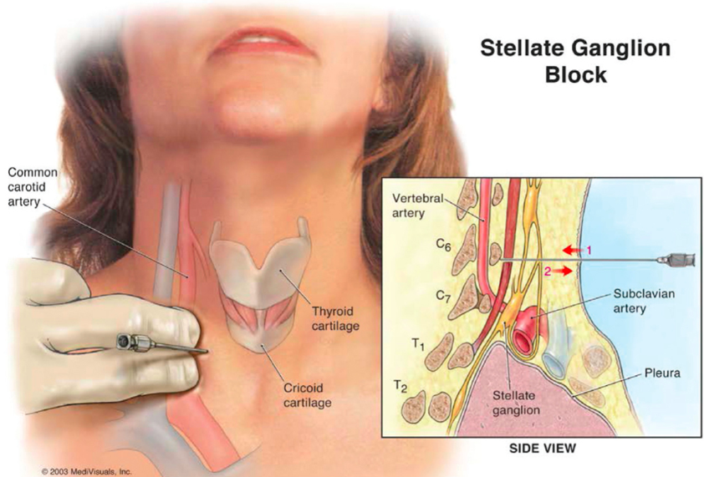
Stellate Ganglion Block (SGB) for PTSD
Status as of 2014
SGB, a well-established pain management procedure, is the first promising biologic treatment that is emerging in the literature for PTSD.
A 5 to 10-minute procedure that involves injecting a local anesthetic at the right-sided C6/C7 cervical vertebrae
Since 2008, numerous reports have documented SGBs rapid effects on reducing PTSD severity among veterans, active duty service members and civilian populations.³¹⁻³⁴
Source: Hickey AH, Navaie M, Stedje-Larsen ET, Lipov EG, McLay RN. Stellate Ganglion Block for the Treatment of Posttraumatic Stress Disorder. Psychiatric Annals 2013; 43(2):87-92.
3

Slide 3
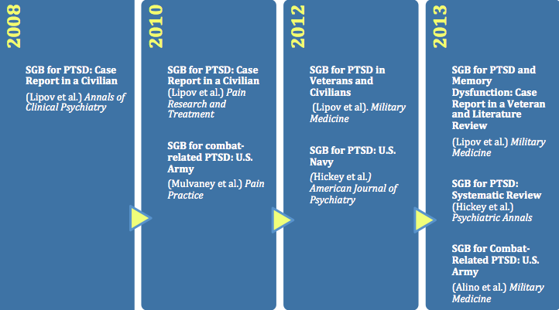
Timeline of Emerging Preliminary Evidence for SGB and PTSD
5

Slide 4
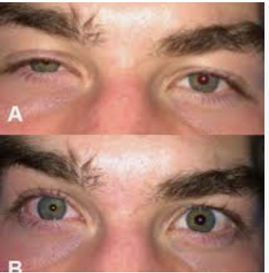
Horner’s Syndrome

Slide 5
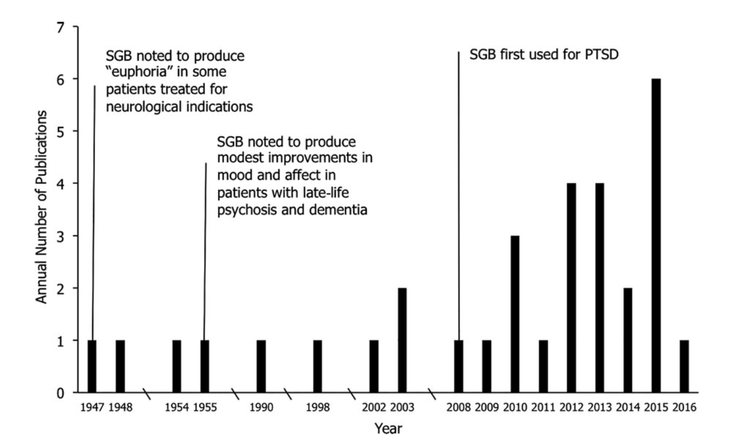
Department of Mental Health, Johns Hopkins Bloomberg School of Public Health, 2017
Summers, Mary R., and Remington L. Nevin. "Stellate ganglion block in the treatment of post‐traumatic stress disorder: A review of historical and recent literature." Pain Practice 17.4 (2017): 546-553.

Slide 6
Risks of Adverse Events Associated with SGB
A study of the incidence of severe complications was last undertaken in 1992 by German researchers Wulf and Maier, with a reported 1.7 complications per 1,000 blockades based on surveys completed by patients receiving a combined total of 45,000 blocks.
Those complications were : Most of these were CNS complications (i.e., convulsions,11). A high subarachnoid block was reported in 6 cases, high epidural blockade in 3, pneumothorax in 9, and allergic reactions in 2. No fatalities or persistent complications were reported
Wulf H, Maier CH (1992) Complications and side effects of stellate ganglion
blockade: Results of a questionnaire survey. Anaesthetist 41: 146-151.
4

Slide 7
How does SGB /CSB work ?

Slide 8
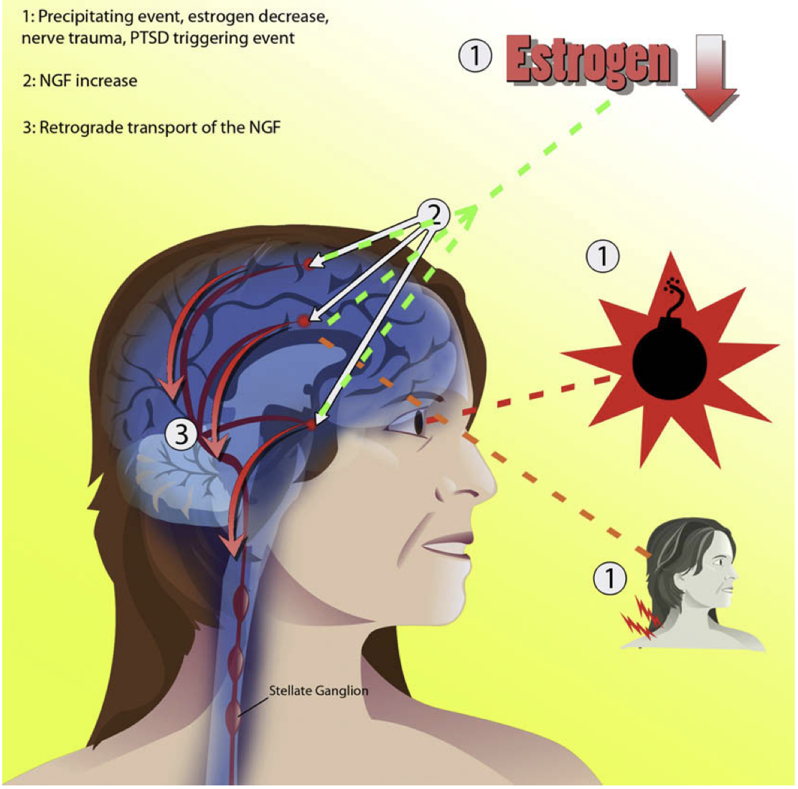
Lipov, Eugene G., et al. "A unifying theory linking the prolonged efficacy of the stellate ganglion block for the treatment of chronic regional pain syndrome (CRPS), hot flashes, and posttraumatic stress disorder (PTSD)." Medical hypotheses 72.6 (2009): 657-661.

Slide 9
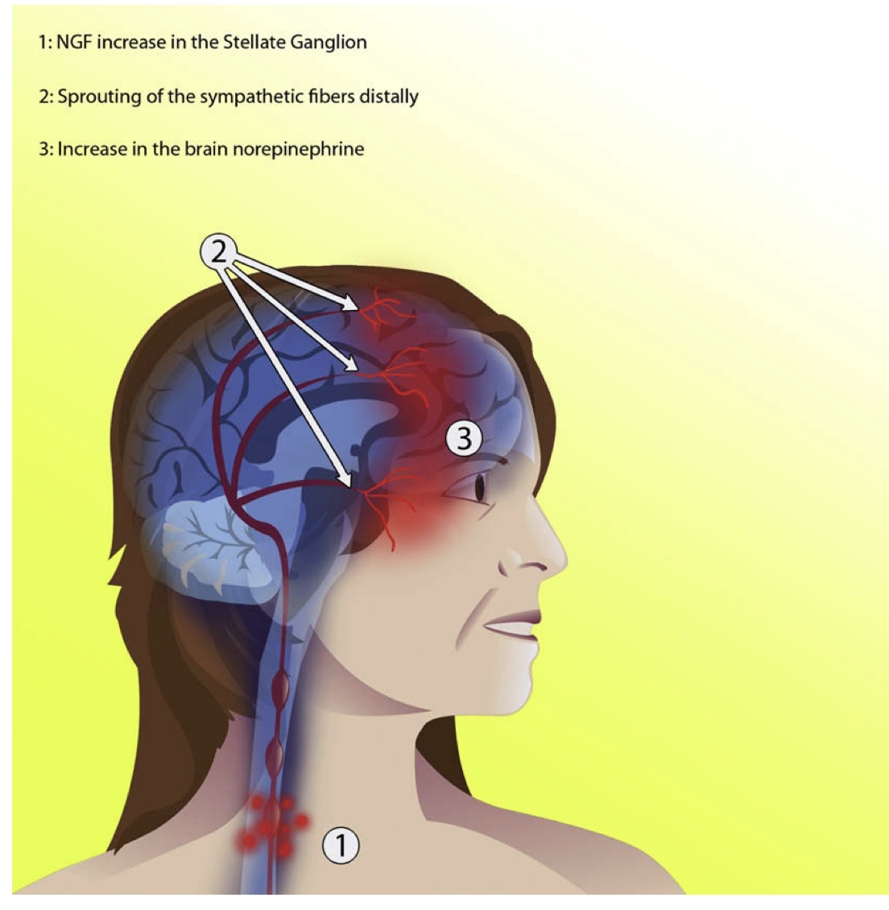
Lipov, Eugene G., et al. "A unifying theory linking the prolonged efficacy of the stellate ganglion block for the treatment of chronic regional pain syndrome (CRPS), hot flashes, and posttraumatic stress disorder (PTSD)." Medical hypotheses 72.6 (2009): 657-661.

Slide 10
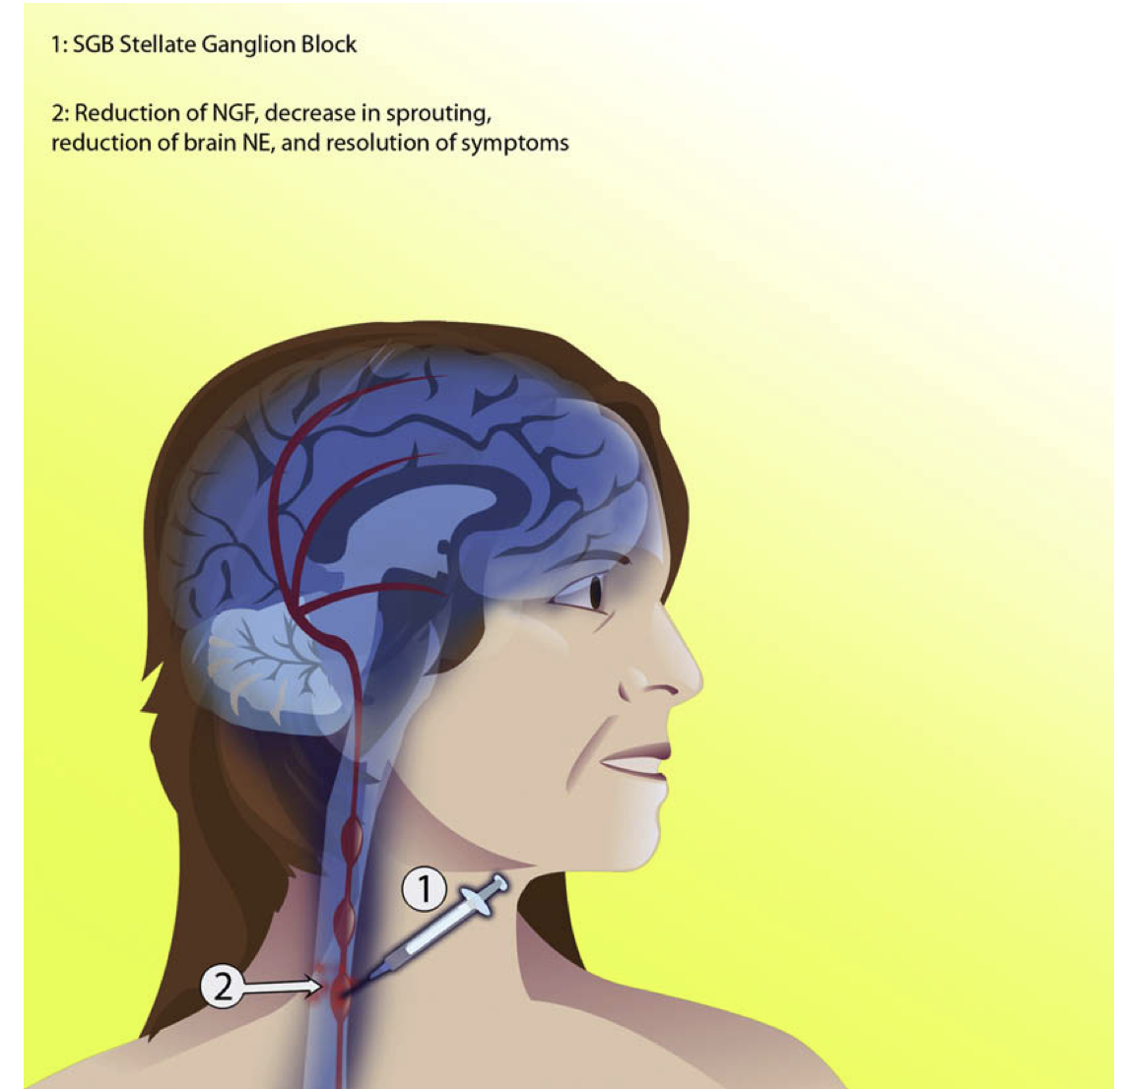
Lipov, Eugene G., et al. "A unifying theory linking the prolonged efficacy of the stellate ganglion block for the treatment of chronic regional pain syndrome (CRPS), hot flashes, and posttraumatic stress disorder (PTSD)." Medical hypotheses 72.6 (2009): 657-661.

Slide 11
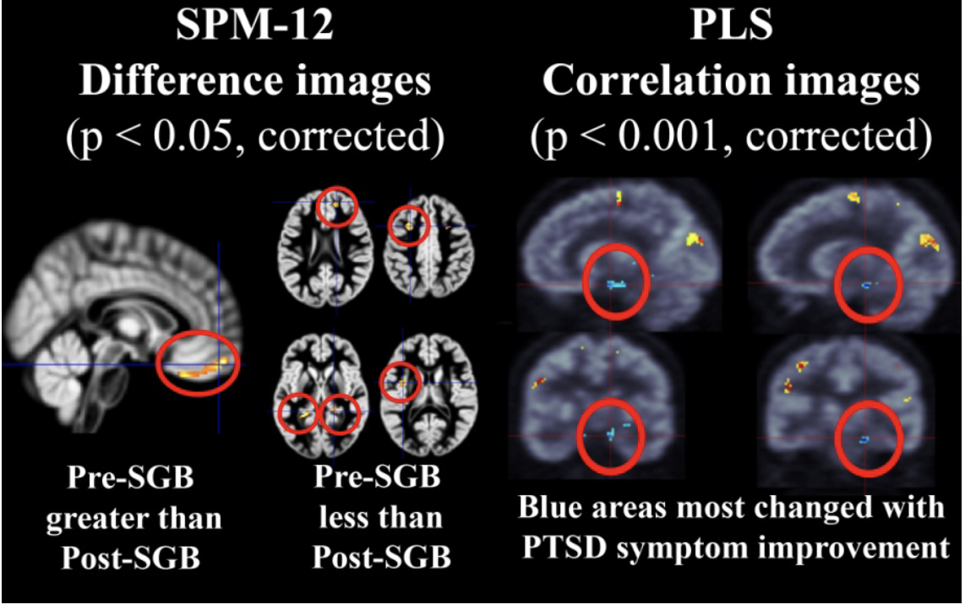
We found stellate ganglion block had efficacy for significantly reducing PTSD symptoms in a
rapid and sustained manner that allowed functional brain glucose metabolic activity to be
compared in the same subjects when they were suffering with PTSD symptoms versus when
they were not. In this small pilot study, the behavioral difference between having and not having
PTSD symptoms appeared to be correlated primarily with differences in right amygdala and
nearby hippocampal functional activity changes.
Alkire, M. T., et al. "Neuroimaging suggests that stellate ganglion block improves post-traumatic stress disorder (PTSD) through an amygdala mediated mechanism." The Anesthesiology Annual Meeting. 2015.

Slide 12
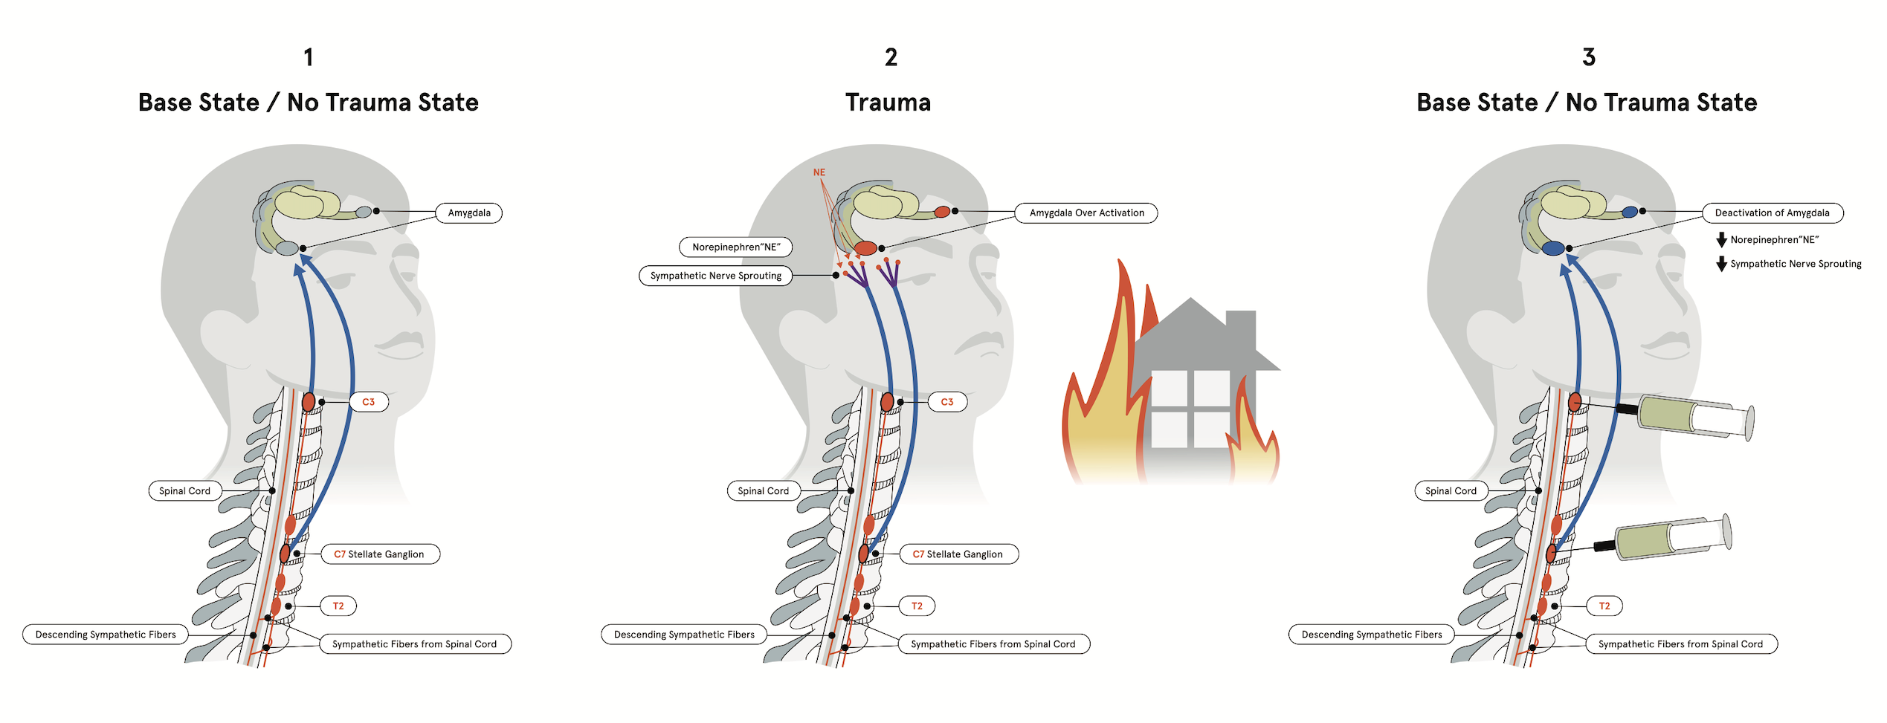

Slide 13
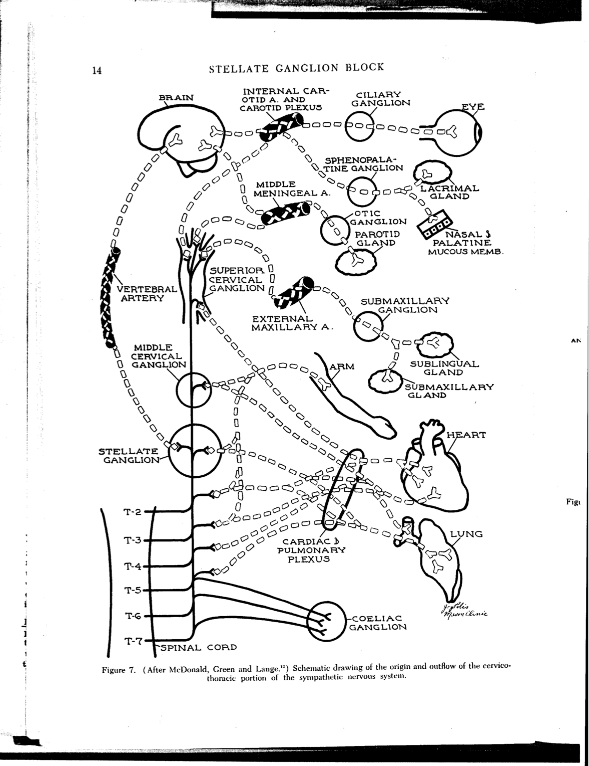
Why do C6 and C4 vs C6
MOORE, D. C. Stellate Ganglion Block: Techniques - Indications - Uses. Springfield: Charles C Thomas.1951. Print

Slide 14
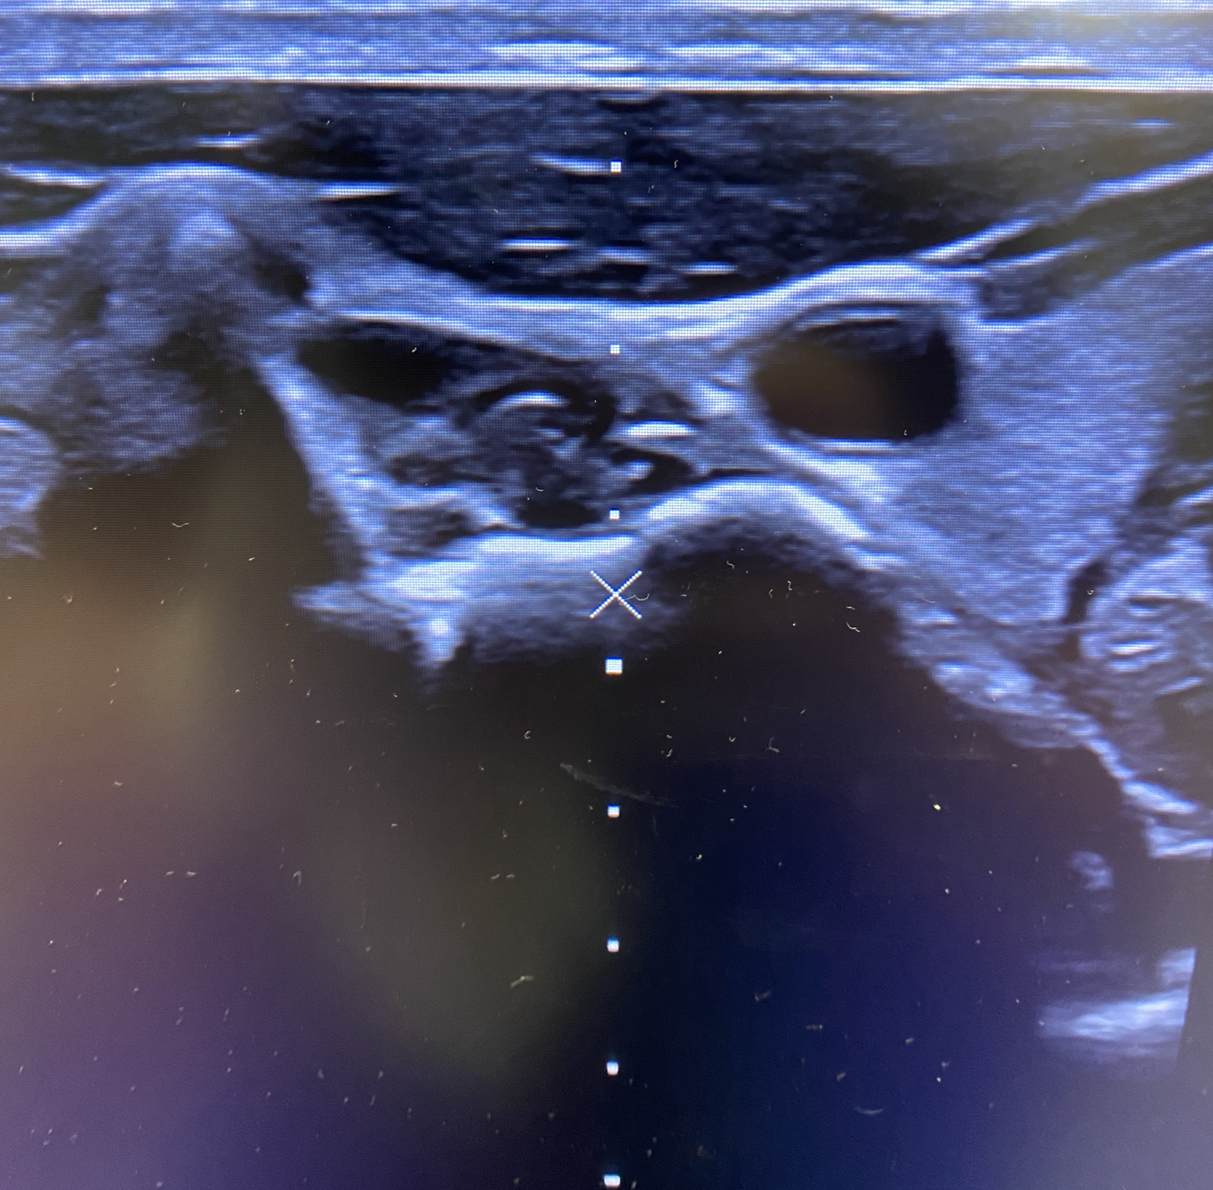
Ultrasound guided CSB

Slide 15
JAMA psychiatry (2020):
RESULTS Of 190 screened individuals, 113 (59.5%; 100 male and 13 female participants;
mean [SD] age, 37.3 [6.7] years) were eligible and randomized (74 to SGB and 39 to sham
treatment), and 108 (95.6%of 113) completed the study. Baseline characteristics were similar in the SGB and sham treatment groups, with mean (SD) CAPS-5 scores of 37.6 (11.2) and 39.8 (14.4), respectively (on a scale of 0-80); 91 (80.0%) met CAPS-5 PTSD criteria. In an intent-to-treat analysis, adjusted mean total symptom severity score change was −12.6 points (95%CI, −15.5 to −9.7 points) for the group receiving SGB treatments, compared with −6.1 points (95%CI, −9.8 to −2.3 points) for those receiving sham treatment (P = .01).
CONCLUSIONS AND RELEVANCE
In this trial of active-duty service members with PTSD symptoms (at a clinical threshold and subthreshold), 2 SGB treatments 2 weeks apart were effective in reducing CAPS-5 total symptom severity scores over 8 weeks. The mild-moderate baseline level of PTSD symptom severity and short follow-up time limit the generalizability of these findings, but the study suggests that SGB merits further trials as a PTSD treatment
adjunct.
Olmsted, Kristine L. Rae, et al. "Effect of stellate ganglion block treatment on posttraumatic stress disorder symptoms: a randomized clinical trial." JAMA psychiatry 77.2 (2020): 130-138.

Slide 16
Latest updates

Slide 17
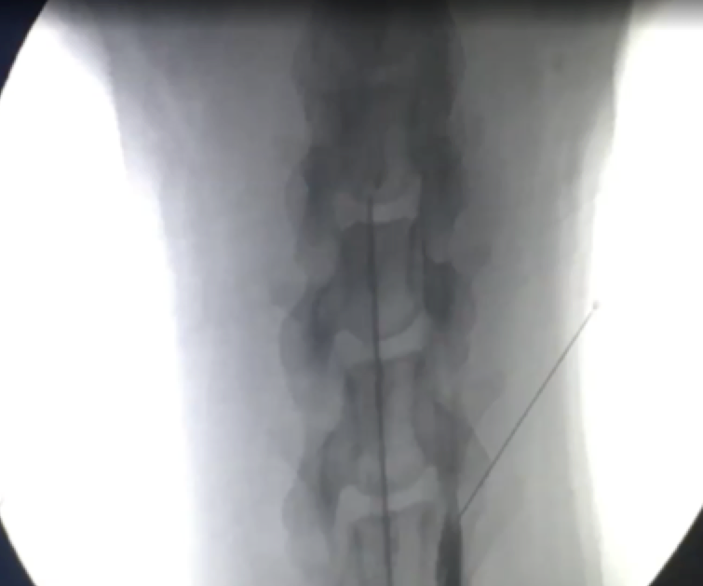
PTSD DOGS and vPTSD

Slide 18
NYU Study 2022,recruiting
Brief Summary:
This study will enroll patients meeting Diagnostic and Statistical Manual of Mental Disorders, Fifth Edition (DSM-5) criteria for post-traumatic stress disorder (PTSD). Following an initial screening visit, clinical assessment, and enrollment, subjects will be randomized into treatment and placebo arms. Both cohorts will undergo a pre-intervention functional magnetic resonance imaging (fMRI) of their brain. Treatment subjects will receive unilateral two-level stellate ganglion block via ultrasound-guided injection of anesthetic (bupivacaine) into the cervical sympathetic tissue; placebo subjects will receive an identical volume of saline via the same procedures.
At approximately 4 weeks post-procedure, both cohorts will then undergo a post-intervention clinical assessment. Finally, both cohorts will undergo a post-intervention fMRI of their brain.
ClinicalTrials.gov Identifier: NCT05391971

Slide 19
DOI: 10.7759/cureus.38888

Slide 20
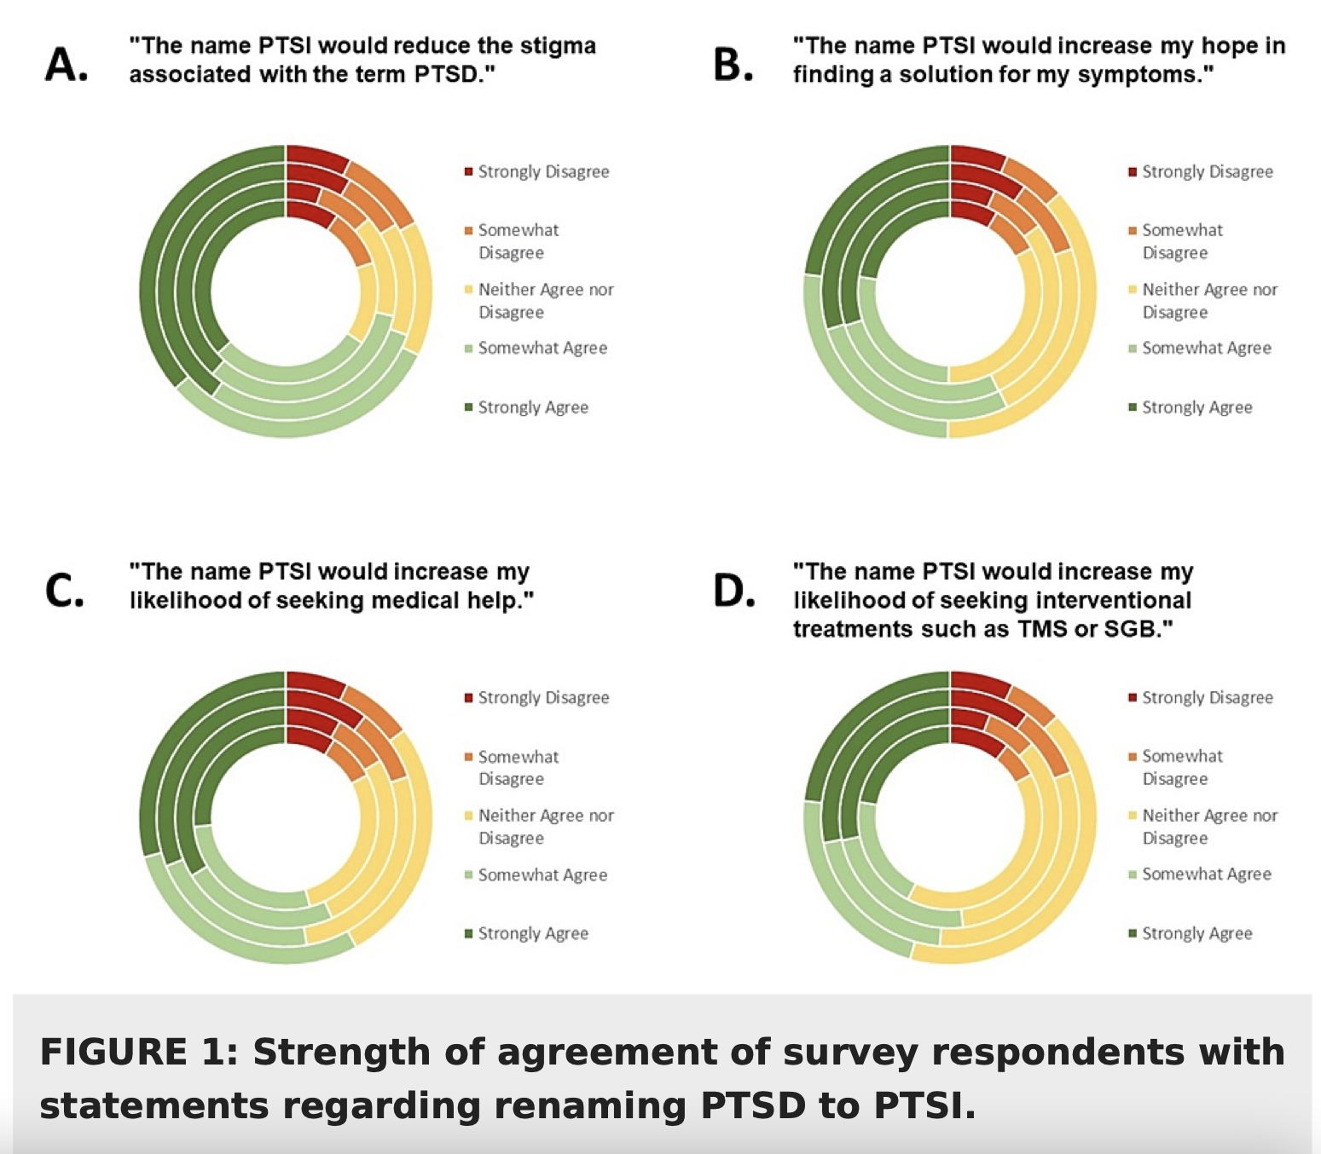

Slide 21
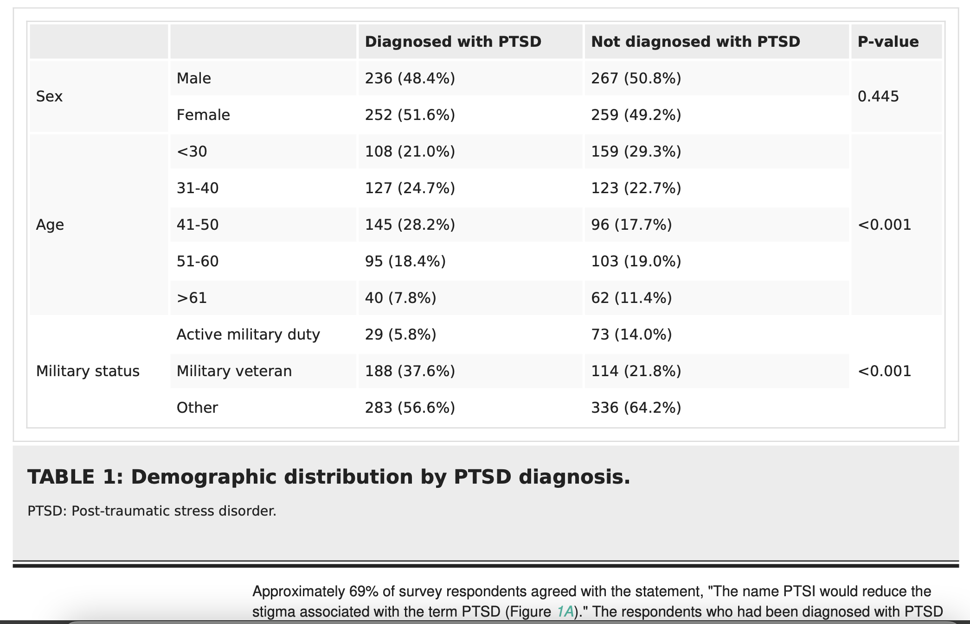

Slide 22
Efficacy of combined subanesthetic ketamine infusion and cervical sympathetic blockade as a symptomatic treatment of PTSD/TBI in a special forces patient with a 1-year follow-up: A case report
KI combined with CSB showed immediate and prolonged benefits 394 days later regarding the symptoms of PTSD, anxiety, depression, suicidal ideation, and cognitive deterioration (patient report). KI combined with CSB can markedly reduce symptoms of PTSD, psychiatric comorbidities, and cognitive dysfunction.
Lipov, Eugene, et al. "Efficacy of combined subanesthetic ketamine infusion and cervical sympathetic blockade as a symptomatic treatment of PTSD/TBI in a special forces patient with a 1-year follow-up: A case report." Heliyon 9.4 (2023).

Slide 23
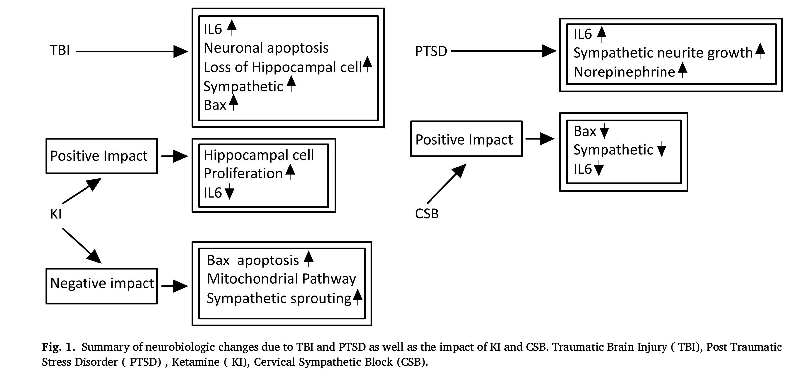

Slide 24
Questions ?
Please contact me c 312 618 0829
elipovmd@aol.com

